Slide 1
Database-I Project 2
A web based application to navigate through Hospital Admission Information.

Slide 2
Entities and their Attributes
PATIENT ; Contains all the patient details with unique Patient_ID. It has the following attributes; Patient_ID(primary key), National_Provider_ID; Age; Sex; Admitting_Diagnosis_Code;
DIAGNOSIS; Contains details about the diagnosis and other attributes. It has the following attributes; Diagnosis; (primary key);Patient_ID(foreign key); Length_of_Stay; Discharge_Status; Stay_Indicator; Total Charges; Surgery Indicator;Provider_City_Name; Bill_Total_per_Diem;
PROCEDURE CODES; Contains procedures for each patient. It has the following attributes; Procedure_ID(primary key) Patient_ID(foreign key);Procedure_Code;

Slide 3
Technologies Used
Xampp- For hosting Apache server.
MySql- For storing and querying our database.
Php- For our client side scripting.
Html & CSS- For UI designing.
FusionCharts wrapper- For Chart designs.

Slide 4
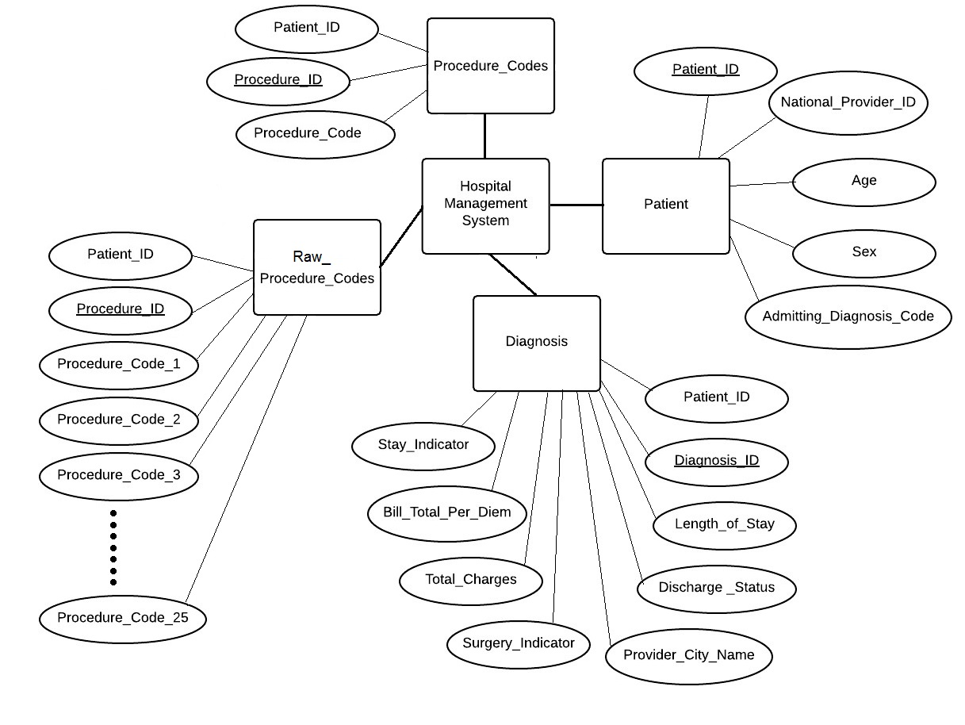
Conceptual Design
ER Diagram

Slide 5
